Slide 1
Introduction to Instrumental Variable Strategy
Methods Workshop
Youngjoon Lee
(2nd Year PhD student / University of Maryland)
March 22, 2021

Slide 2

Notes: Kee Hyun Park shared this video with me on February 19, 2021. Original file is available at
https://twitter.com/i/status/1362636561813303297
1/15

Slide 3


Structure of My Presentation (45 min)
1. When We Need An Instrumental Variable Strategy
2. When We Can Use An Instrumental Variable Strategy
3. How to Interpret Tables
4. Useful R Codes
5. Quiz
2/15

Slide 4
Structure of the Methods Workshop
Evan
(Feb 15)
Kee Hyun
Xiaonan (Mar 8)
Youngjoon
Chase
(Apr 5)
Alauna, Autumn,
William (Apr 19)
General
information
Observational
Studies
Experimental
Studies
DiD Methods
Fixed Effects
Instrumental
Variable
Regression
Discontinuity
Independent Variable:
Binary
Independent Variable:
Binary / Continuous
Independent Variable:
Binary
3/15

Slide 5
When We Need An Instrumental Variable Strategy
1. Reverse Causality
(e.g., Dissent-Repression Nexus)
2. Measurement Error
(e.g., # of officials punished for corruption = corruption level?)
3. Omitted Variables
4/15

Slide 6
When We Need An Instrumental Variable Strategy
Dissent-Repression Nexus
Dissent ↑ → Repression ↑ & Repression ↑ → Dissent ↓
Our Hypothesis
First-Stage Regression
Strike_{i,t} = τ + ωCasualties_{i,t-1} + ηδ_{i,t} + ε_{i,t}
TSLS
Model
Second-Stage Regression
Repress_{i,t} = α + βStrike_{i,t} + ηδ_{i,t} + ε_{i,t}
5/15

Slide 7
When We Need An Instrumental Variable Strategy
First Quiz
10$
First Come First Serve: Message to Chat
Model 1 (No TSLS / Simple OLS)
Repress_{i,t} = α + β₁Strike_{i,t} + ηδ_{i,t} + ε_{i,t}
Statement: β₂ should be bigger than β₁.
Is this statement correct?
1) Yes
2) No
Model 2 (Yes TSLS)
Repress_{i,t} = α + β₂Strike_{i,t} + ηδ_{i,t} + ε_{i,t}
6/15

Slide 8
When We Can Use An Instrumental Variable Strategy
Assumption: the number of instrumental variable = the number of endogenous regressor.
1. **Strong Instrument**
First-Stage Regression
Strike_{i,t} = τ + ωCasualties_{i,t-1} + ηδ_{i,t} + ε_{i,t}
Testable: F-Statistic: bigger than 10.00
2. **Valid Instrument (Exclusion Restriction)**
Strike_{i,t} = τ + ωCasualties_{i,t-1} + ηδ_{i,t} + ε_{i,t}
Not Testable
Repress_{i,t} = α + βStrike_{i,t} + ηδ_{i,t} + ε_{i,t}
3. Exogenous Instrument
Not Testable
7/15

Slide 9
Examples of Instrumental Variable Strategies (TSLS)
1. Ritter and Conrad (2016): Africa / US
Rainfall → Count Number of Protest → Count Number of Protests Repressed by Governments
2. Guriev, Melnikov, and Zhuravskaya (2020): Global
Lightning Strikes → Mobile Usage Expansion → Government Trust (Yes or No)
3. Rogowski, Gerring, Maguire, and Cojocaru (2021): US
County Vote Shares for the Congressional Candidates from the Incumbent President’s Party
→ Number of Post Offices → Economic Outputs from Agriculture and Manufacturing Sectors.
8/15

Slide 10
Examples of Instrumental Variable Strategies (TSLS)
Second Quiz
10$
First Come First Serve: Message to Chat
Which of the following statement (s) is (are) correct?
(a) Whether the selected instrument is strong is not testable.
(b) Control variables need to be included both in the first and second stage regressions.
(c) Rogowski et al. (2021)’s instrumental variable is in face exogenous.
1. (a) 2. (b) 3. (c) 4. (a) (c) 5. (b) (c)
9/15

Slide 11
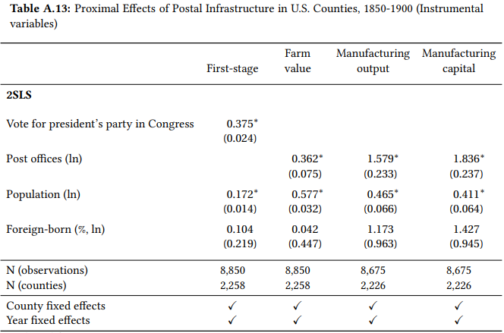
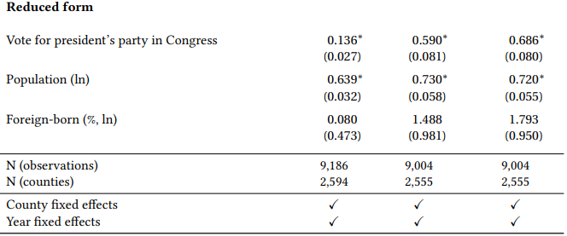
How to Interpret Tables
2. The same control variables should be included in both 1st/2nd stage regressions
1. Please locate 1) the instrumental variable, 2) independent variable, and 3) dependent variable!
3. You may choose whether to report the results using the reduce form.
4. You should report the F-statistic value.
Source: Rogowski et al. 2021. “Public Infrastructure and Economic Development: Evidence from Postal Systems.”
American Journal of Political Science Published Online (March 3, 2021).
10/15

Slide 12
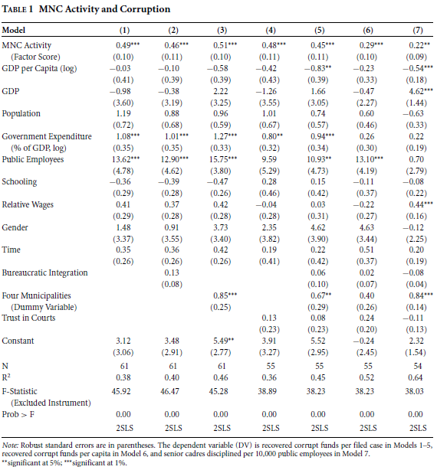

How to Interpret Tables
1. Please locate 1) the instrumental variable, 2) independent variable, and 3) dependent variable!
I can’t find the instrumental variable!
= Reports using
a reduced form!
2. F-Statistic value
Source: Zhu. 2017. “MNCs, Rents, and Corruption: Evidence from China.” American Journal of Political Science 61 (1).
11/15

Slide 13
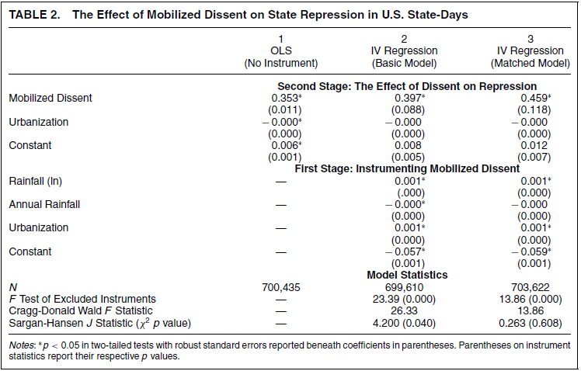

How to Interpret Tables
1. Please locate 1) the instrumental variable, 2) independent variable, and 3) dependent variable!
2. Urbanization variable
was included in both
1st/2nd stage regressions.
3. F-Statistic value
4. What is this????
Source: Ritter and Conrad. 2016. “Preventing and Responding to Dissent: The Observational Challenges of Explaining
Strategic Repression.” American Political Science Review 110 (1).
H₀: The instrumental variables can be “jointly” used.
12/15

Slide 14
Useful R Codes
ivreg(Y ~ X + W | W + Z, data = hello)
Y: Dependent Variable
X: Endogenous Independent Variable
Z: Instrumental Variable
W: Control Variables
13/15

Slide 15
What We Have Learned Today
1. Assumptions Matter.
- Strong Instrument
- Valid Instrument
- Exogenous Instrument
Testable
Not Testable
Not Testable
2. Please Compare TSLS Results with OLS Results.
3. Please Note that You Can Adopt More Than One Instrument to
Instrument One Independent Variable.
14/15

Slide 16
What We Need to Learn in the Future
If I am given one additional opportunity..
Advanced Instrumental Variable Strategy
Table of Contents
1. Instrumental Variable Strategy + Lagged Dependent Variable Model
2. Instrumental Variable Strategy + Interaction Terms
3. When the Number of Instruments > the Number of Endogenous Regressors
4. Instrumental Variable Strategy + Matching Techniques
5. Instrumental Variable Strategy + Survival Models
6. Endogeneity Test
15/15

Slide 17
Thank you
I hereby note that Kee Hyun Park and Xiaonan Wang’s suggestions were very helpful.

